Slide 1
Object Oriented Software Engineering (OOSE)
22CS017
Introduction to Interaction Diagrams

Slide 2
Contents
Introduction to Interaction diagrams
Purpose of Interaction Diagrams
Draw an Interaction Diagram
Sequence Diagram
Collaboration Diagram
Use of Interaction Diagrams

Slide 3
Introduction to Interaction diagrams
From the term Interaction, it is clear that the diagram is used to describe some type of interactions among the different elements in the model.
This interaction is a part of dynamic behavior of the system.
This interactive behavior is represented by two diagrams known as
1. Sequence diagram and
2. Collaboration diagram.
The basic purpose of both the diagrams are similar.
Sequence diagram emphasizes on time sequence of messages and collaboration diagram emphasizes on the structural organization of the objects that send and receive messages.

Slide 4
Purpose of Interaction Diagrams
The purpose of interaction diagrams is to visualize the interactive behavior of the system. Visualizing the interaction is a difficult task. Hence, the solution is to use different types of models to capture the different aspects of the interaction.
Sequence and collaboration diagrams are used to capture the dynamic nature but from a different angle.
The purpose of interaction diagram is −
To capture the dynamic behavior of a system.
To describe the message flow in the system.
To describe the structural organization of the objects.
To describe the interaction among objects.

Slide 5
How to Draw an Interaction Diagram?
The purpose of interaction diagrams is to capture the dynamic aspect of a system. So to capture the dynamic aspect, we need to understand what a dynamic aspect is and how it is visualized. Dynamic aspect can be defined as the snapshot of the running system at a particular moment.
Two types of interaction diagrams.
One is the sequence diagram and the other is the collaboration diagram.
The sequence diagram captures the time sequence of the message flow from one object to another and the collaboration diagram describes the organization of objects in a system taking part in the message flow.
Following things are to be identified clearly before drawing the interaction diagram
Objects taking part in the interaction.
Message flows among the objects.
The sequence in which the messages are flowing.
Object organization.

Slide 6
Interaction Diagrams
Example:
Order Management System

Slide 7
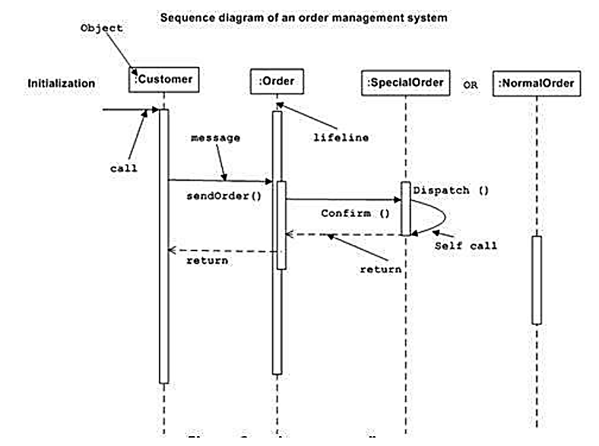
(1) The Sequence Diagram

Slide 8
Cont..
The sequence diagram has four objects (Customer, Order, SpecialOrder and NormalOrder).
The following diagram shows the message sequence for SpecialOrder object and the same can be used in case of NormalOrder object. It is important to understand the time sequence of message flows. The message flow is nothing but a method call of an object.
The first call is sendOrder () which is a method of Order object. The next call is confirm () which is a method of SpecialOrder object and the last call is Dispatch () which is a method of SpecialOrder object. The following diagram mainly describes the method calls from one object to another, and this is also the actual scenario when the system is running.

Slide 9
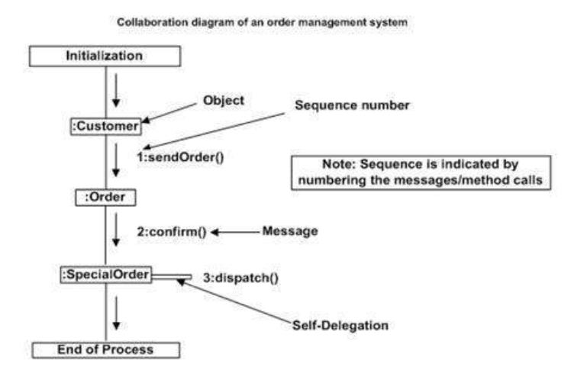
(2) The Collaboration Diagram

Slide 10
Cont..
The second interaction diagram is the collaboration diagram. It shows the object organization as seen in the following diagram. In the collaboration diagram, the method call sequence is indicated by some numbering technique. The number indicates how the methods are called one after another. We have taken the same order management system to describe the collaboration diagram.
Method calls are similar to that of a sequence diagram. However, difference being the sequence diagram does not describe the object organization, whereas the collaboration diagram shows the object organization.
To choose between these two diagrams, emphasis is placed on the type of requirement. If the time sequence is important, then the sequence diagram is used. If organization is required, then collaboration diagram is used.

Slide 11
Where to Use Interaction Diagrams?
The main purpose of both the diagrams are similar as they are used to capture the dynamic behavior of a system. However, the specific purpose is more important to clarify and understand.
Sequence diagrams are used to capture the order of messages flowing from one object to another.
Collaboration diagrams are used to describe the structural organization of the objects taking part in the interaction.
A single diagram is not sufficient to describe the dynamic aspect of an entire system, so a set of diagrams are used to capture it as a whole.

Slide 12
Cont..
Interaction diagrams are used when we want to understand the message flow and the structural organization.
Message flow means the sequence of control flow from one object to another.
Structural organization means the visual organization of the elements in a system.
Interaction diagrams can be used −
To model the flow of control by time sequence.
To model the flow of control by structural organizations.
For forward engineering.
For reverse engineering.

Slide 13
Examples: Interaction Diagrams

Slide 14
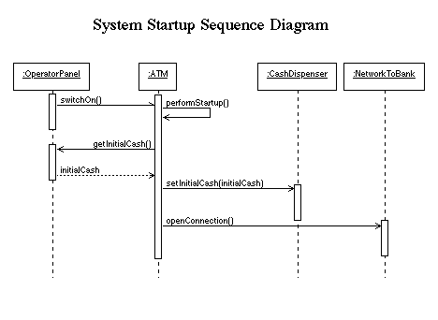
System Start up Diagram

Slide 15
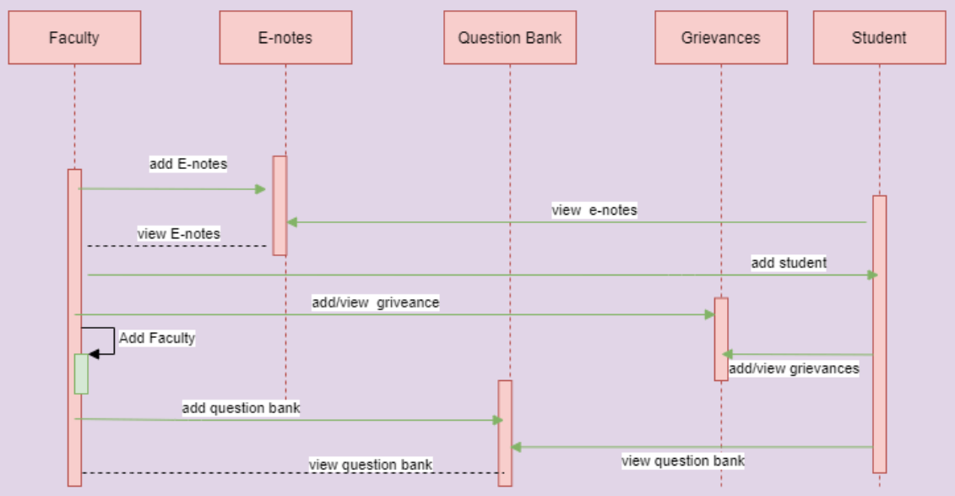
College Management System

Slide 16
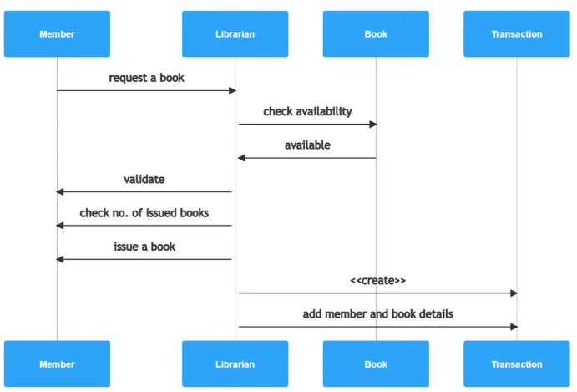
Interaction diagram of library management system

Slide 17
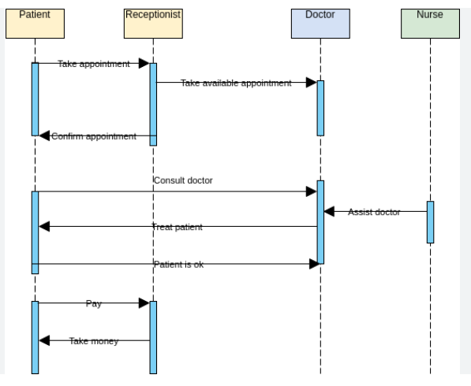
Interaction diagram of hospital management system

Slide 18
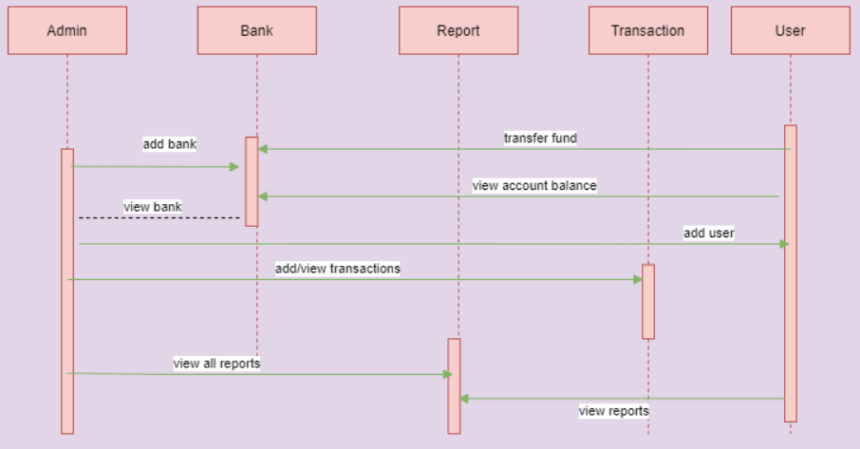
Interaction diagram of bank system

Slide 19
Practice Questions ?
Draw the collaboration diagram for College information system.
Draw the collaboration diagram for Library Management system.
Draw the collaboration diagram for Hospital Management System.
Draw the collaboration diagram for Banking System.

Slide 20
Bibliography
https://codebun.com/uml-diagram-for-bank-management-system/
https://www.freeprojectz.com/uml-diagram/college-management-system-sequence-diagram
https://www.tutorialspoint.com/software_testing_dictionary/alpha_testing.htm
https://www.tutorialspoint.com/software_testing_dictionary/validation_testing.htm
https://www.tutorialspoint.com/software_testing_dictionary/acceptance_testing.htm

